Slide 1
Research on the Influence of Celebrity Nickname Lipsticks on Consumers' Purchase Intention

Slide 2

Contents
Introduction
Method
01
04
Literature Review
Result
02
05
Hypothesis & Research Model
Conclusion
03
06

Slide 3
01 Introduction

Slide 4

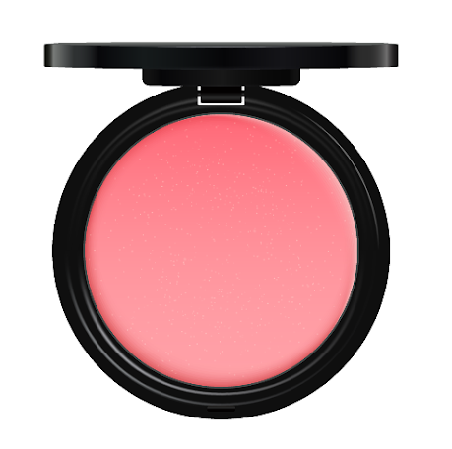
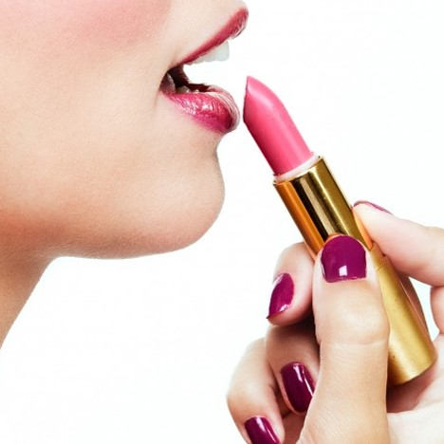
Introduction
Why Lipsticks?
As a kind of "cheap luxury goods", lipsticks maintain high sales in the both periods of economic booms and busts.
What’s the Problem?
Homogenization of the lipsticks.
General nomenclature of "brand + series + product".
Lipstick shade becomes the main factor in stimulating the purchasing intentions of consumers.
How’s the present situation?
Refinement of the lipsticks.
New nomenclature of "the celebrity nickname".
Celebrity appeal helps consumers express their identity, social status and emphasize the uniqueness.

Slide 5
02 Literature Review

Slide 6
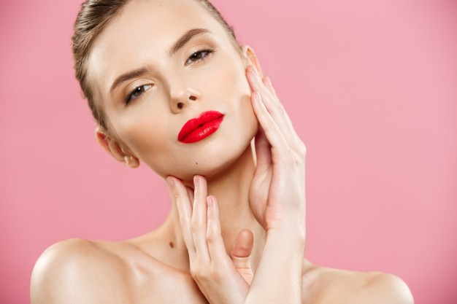
Andrade & Cohen, 2007: People desire to eliminate negative emotions and try to stay in happy situations when in sadness situation.
Forgas, 1995: The difference between emotion and mood.
Lopez & de Maya, 2012: One's mood impacts on how he responds to the new stimulus.
Literature Review
Miller & Kahn, 2005： Classified color names into four categories and confirmed the popularity of each naming style with two dimensions.
Skorinko, Kemmer, Hebl & Lane, 2006：Generic and fancy color names were used to uncover people's perception of color and its influence on decision-making.
Color Name
Influence Regulation Theory
Fein & Spencer 1997：Self-image is a component of self-concept, it depicts details that can be objectively investigated by others and people learning about themselves through personal experience or internalizing the judgments of others.
Hosany & Martin 2012: Consumers are more inclined to purchase commodities and services that reflect what they see in the mirror or that make them look even better in the mirror.
Incongruity theory
Self-image theory
Mandler，1982：The relationship between the degree of incongruity in the message and consumer’s attitude assessment appears to be performed in a nonlinear and Inverted-U shape manner.

Slide 7
03 Hypothesis & Research Model

Slide 8
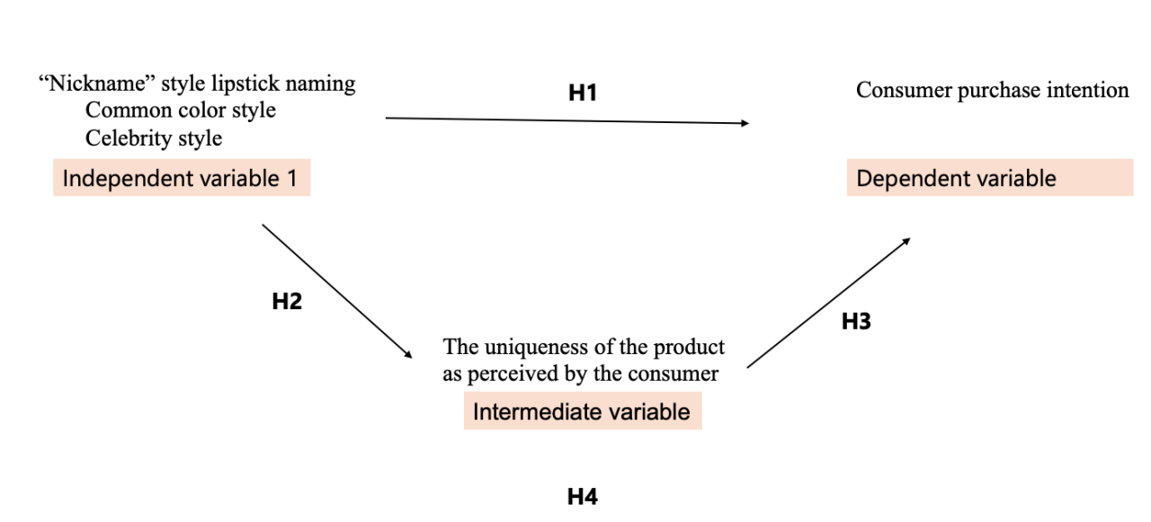
Hypotheses and Research Model
Independent variable
“Nickname” style lipstick naming
Intermediate variable
The uniqueness of the product as perceived by the consumer
Dependent variable
Consumer purchase intention
H1: “Nickname” lipstick naming style affects consumer purchase intention.
H2: “Nickname” style lipstick naming affects the uniqueness of the product as perceived by the consumer.
H3: The uniqueness of the product as perceived by the consumer affects consumer purchase intention.
H4: “Nickname” style lipstick naming affects consumer purchase intention by the uniqueness of the product as perceived by the consumer.

Slide 9
Justification for H1
The theory of conversational implicatures
Lipstick marketing customers perceive that marketers in introduction language use to aid purchase (Wansink & Chandon, 2006).
As soon as the marketing information delivered to customers does not cover the product information well or if it differs from expectations, the consumers begin to imagine or guess the very reasons to explain this ambiguity or deviation from expectations (Kronrod & Huber, 2015).
“Nickname” lipstick naming style
Consumer purchase intention
H1: “Nickname” lipstick naming style affects consumer purchase intention.

Slide 10
Justification for H2
Research shows that consumers also associate an "unusual" product with a "unique" product (Bressler, 2022).
A special model represents the attitudinal, cognitive, and affective variables of consumers that are broadly used to find key sensory, imaginal, functional, emotional, and other attributes that make the product unique (Cohen, 1990).
“Nickname” lipstick naming style
The uniqueness of the product as perceived by the consumer
H2: “Nickname” style lipstick naming affects the uniqueness of the product as perceived by the consumer.

Slide 11
Justification for H3
The perceived uniqueness of the self-designed products is an independent variable of the consumer experience utility, and it is mediated by consumers' preferences for uniqueness (Tian, et al. 2001).
Products do not have to be completely different for their uniqueness to catch consumers' attention, and a very distinctive product may not even guarantee any market success (Lagerlöf, 2006).
The uniqueness of the product as perceived by the consumer
Consumer purchase intention
H3: The uniqueness of the product as perceived by the consumer affects consumer purchase intention.

Slide 12
Justification for H4
The uniqueness of the product as perceived by the consumer
“Nickname” lipstick naming style
Consumer purchase intention
H4: “Nickname” style lipstick naming affects consumer purchase intention by the uniqueness of the product as perceived by the consumer.

Slide 13
04 Method

Slide 14
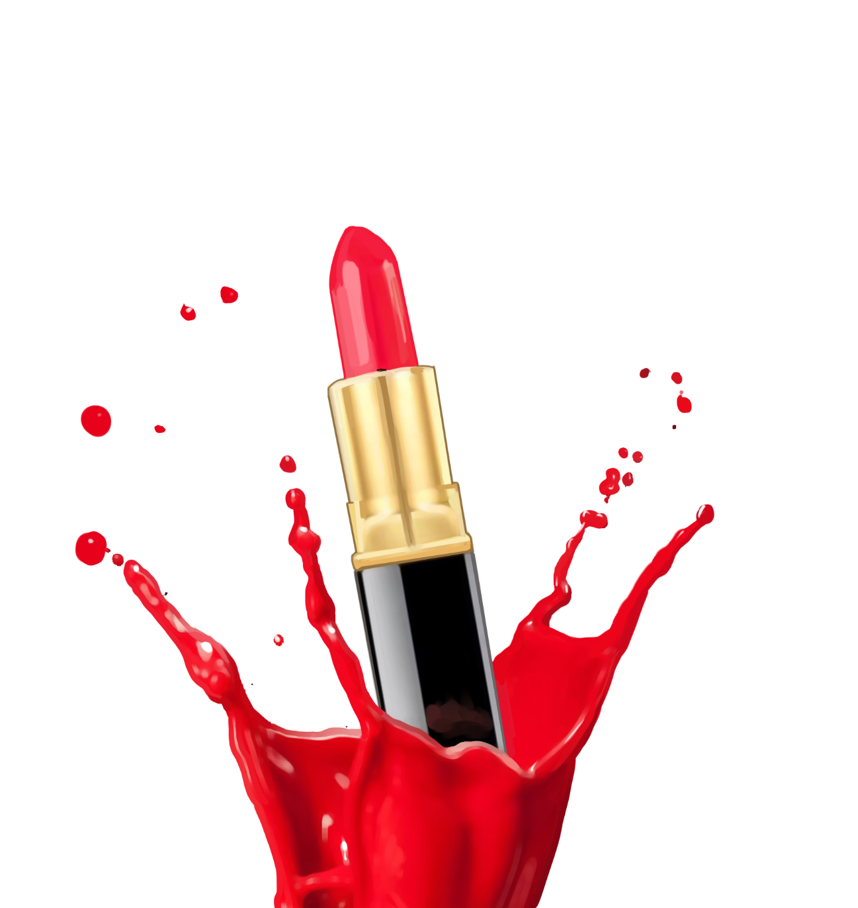
Sampling
Targeted selection of samples
Control the size
Representative
More efficient and economical
Purposive Sampling
200 questionnaires
Age group of 20-39 years old
Frequency of using lipstick as occasional, frequent, and daily.
Questionnaire

Slide 15
Research Method:Experiment
,
perception of the uniqueness of different lipsticks, willingness to purchase
normal color
type
Control
Group
stimulus
perception of the uniqueness of different lipsticks, willingness to purchase
Experimental
Group
celebrities type

Slide 16
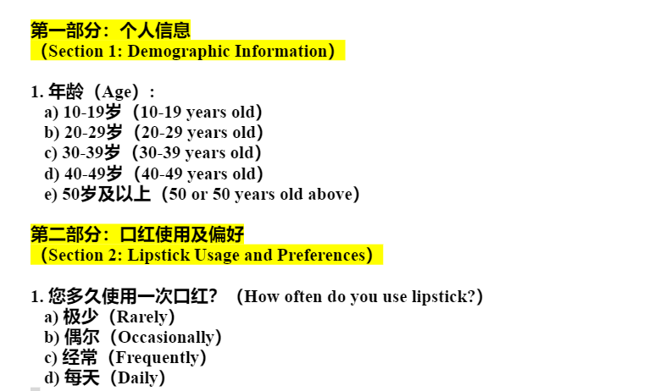
Measurement Instrument: Questionnaire
The first part is the basic information of the participants, including age and frequency of using lipstick.

Slide 17
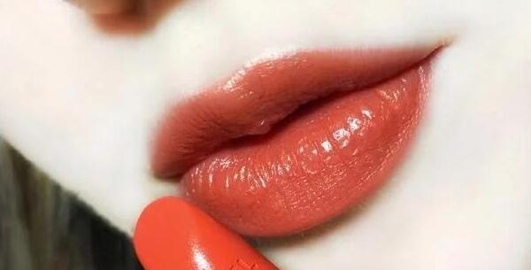

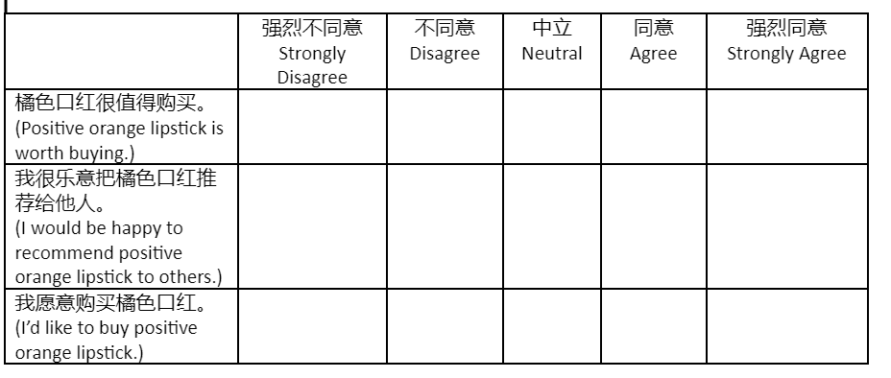
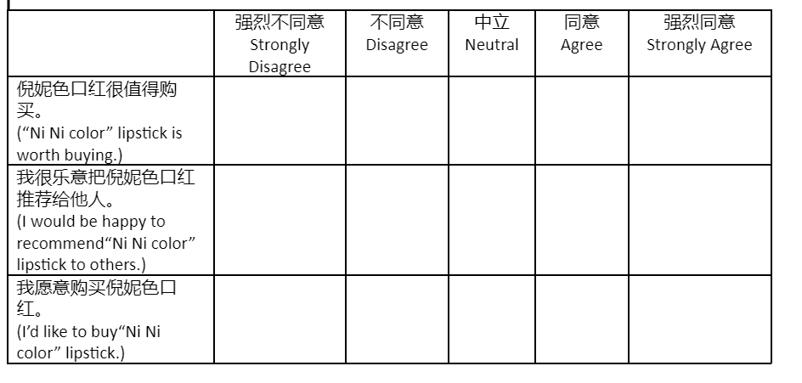
Measurement Instrument: Questionnaire
The second part is the nickname of the lipstick.
control
group
experimental
group

Slide 18
Data Analysis Process
Reliability:Cronbach's alpha
Validity:Factor analysis
independent variable:nominal measurement,
mediator variable:continuous variable,
dependent variable: continuous variable.
Hypothesis 1: two independent samples t-test
Hypothesis 2: two independent samples t-test
Hypothesis 3: linear regression analysis
Hypothesis 4: mediated effects test procedure described by Kenny and colleagues is the more widely used test procedure

Slide 19
05 Result

Slide 20
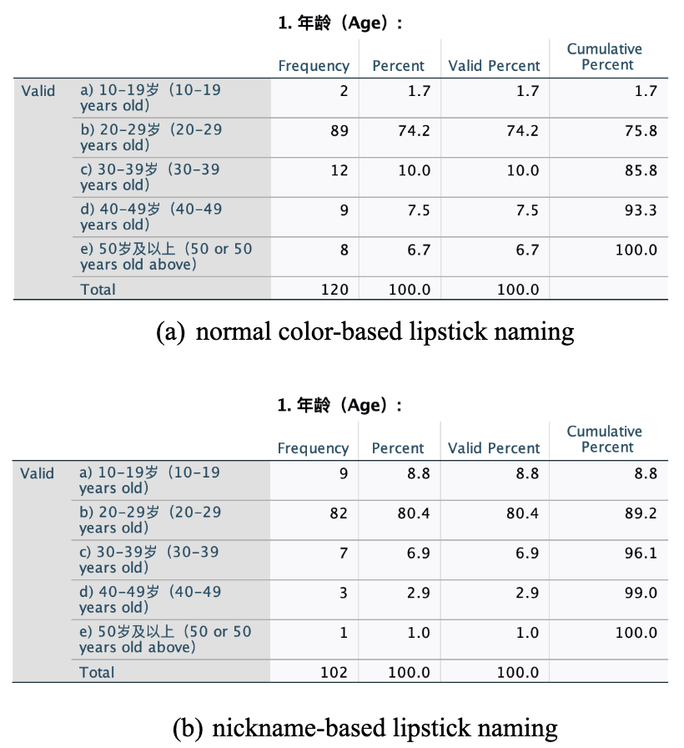
5.1 Descriptive statistical analysis
222 responses received for comparing nickname-based and color-based lipstick naming methods.
Consistent opinions on lipstick intensity among respondents aged 20-29.
Little age variation observed between the two sample groups.

Slide 21
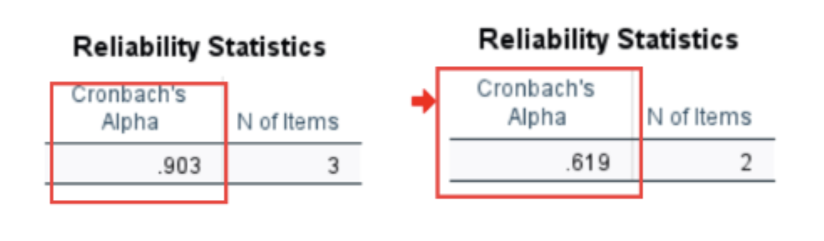
5.2 Reliability analysis
Cronbach's alpha coefficient > 0.6 indicates questionnaire reliability, confirming effective measurement of purchase intention and perceived product uniqueness.

Slide 22
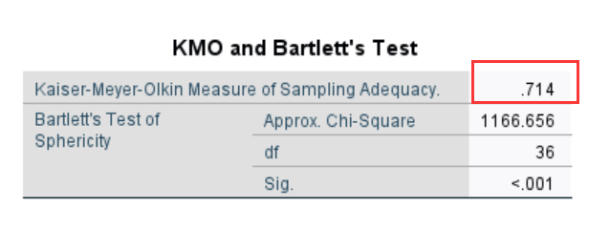
5.3 Validity analysis
Study used exploratory factor analysis for validity assessment. Results (KMO=0.714, Bartlett Test sig<0.001) indicate data suitability for factor analysis.

Slide 23
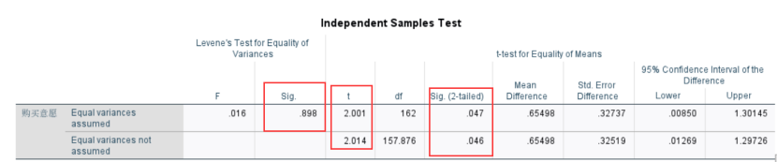
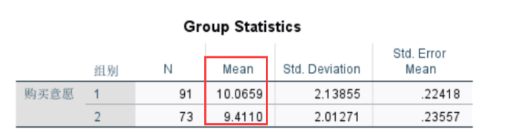
5.4 Hypothesis Testing
Hypothesis 1
Statistical analysis indicates a significant difference in customer purchase intention between nickname-based and normal color-based lipstick naming styles (sig=0.047<0.05).
However, it's important to note that the mean value for normal color-based lipstick naming style is higher.
As a result, hypothesis one is not valid.

Slide 24
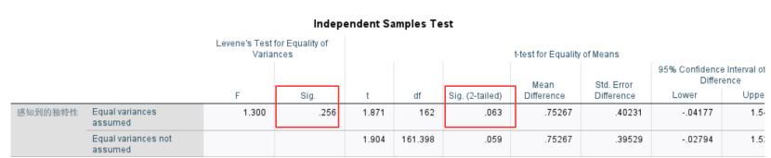
5.4 Hypothesis Testing
Hypothesis 2
Statistical analysis (sig=0.063>0.05) reveals no significant difference in the effect of nickname-based and normal color-based lipstick naming styles on product uniqueness.
Hypothesis two is not valid.

Slide 25
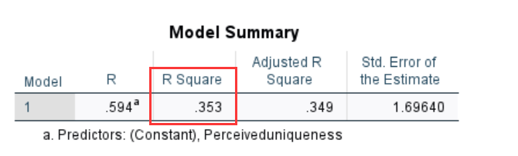
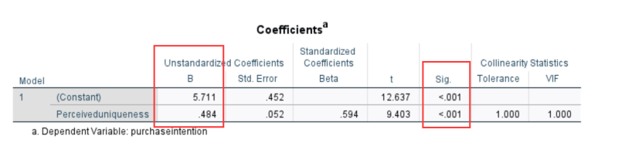
5.4 Hypothesis Testing
Hypothesis 3
Regression analysis (R*R=0.353) indicates that consumer-perceived uniqueness explains 35.3% of the variance in purchase intention.
The regression model is valid (sig<0.001<0.05) with a coefficient of 0.484.
Increase of 1 in consumer-perceived uniqueness corresponds to a 0.484 increase in purchase intention.
Hypothesis 4
Hypothesis two (lipstick naming style's effect on consumer-perceived uniqueness) is not significant.
Mediating effect premise is not satisfied, rendering hypothesis four invalid.

Slide 26
5.5 Result
Different lipstick naming styles (color-based and celebrity-based) have a significant effect on purchase intention, but consumers preferred normal color naming.
Celebrity lipstick naming does not increase consumer perceived uniqueness, potentially due to unattractive celebrities or a lack of fundamental differentiation.
Higher perceived uniqueness positively impacts purchase intentions, aligning with the need for recognition and uniqueness.
Stimulating purchase intention can be achieved through personalized and customized advertisements or products.

Slide 27
06 Conclusion

Slide 28
Summary of Findings
Consumers have different purchasing intentions for different lipstick naming styles, but compared to celebrity naming, normal color naming style is more popular.
Celebrity naming style does not play a role in consumers' perceived uniqueness, but consumers' perceived uniqueness does have a positive impact on purchase intention.

Slide 29
Limitations
Sampling method
Questionnaire
Celebrities

Slide 30
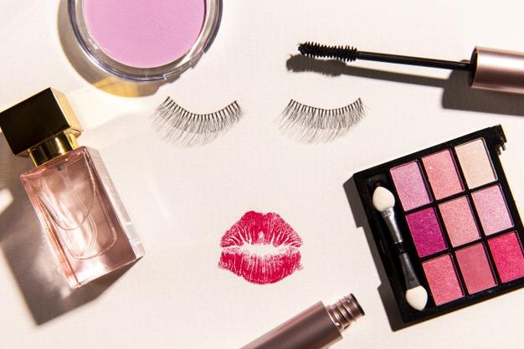
Implications
Theoretical Significance
Practical Significance
This study starts from a specific naming style, that is, celebrity naming, and deeply explores the impact of naming styles on consumers' perception of uniqueness from the psychological level. It fills the gap in this field and is of innovative significance.
Product naming styles: adjective naming, role identity naming style, ect.
Improve consumers' perception of the uniqueness of the product: customized services, personalized advertising, etc.

Slide 31
THANKS！

